Slide 1
STM32 Development Tool

Slide 2
Agenda
Embedded System Overview
Embedded C
Keil-C Simulator
Sample Project

Slide 3

Development Tools
The development tools include:
Compiler
Debugger
In-Circuit Serial Programmer (ICSP)
Common Development IDE include:
Keil MDK ARM
STM32 CubeIDE
Segger Embedded Studio

Slide 4
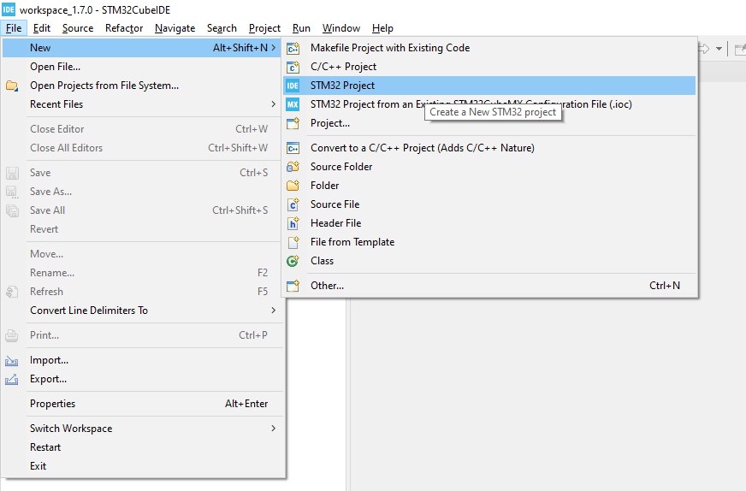
STM32CUBE IDE – New Project

Slide 5
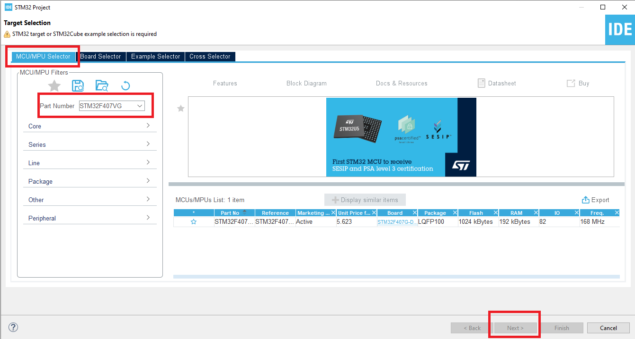
STM32CUBE IDE – Select MCU

Slide 6
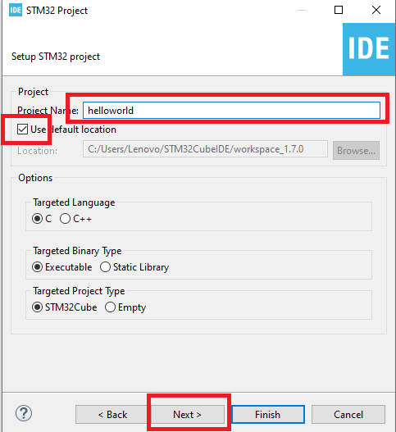
STM32CUBE IDE – Select MCU

Slide 7
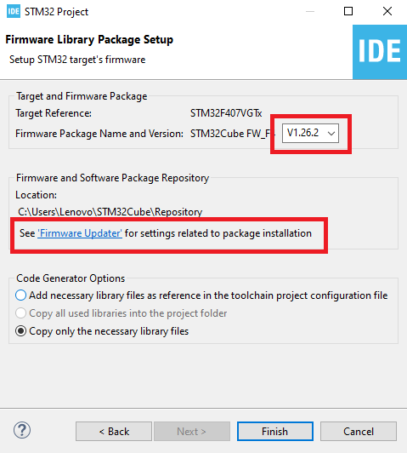
STM32CUBE IDE – FW Package

Slide 8
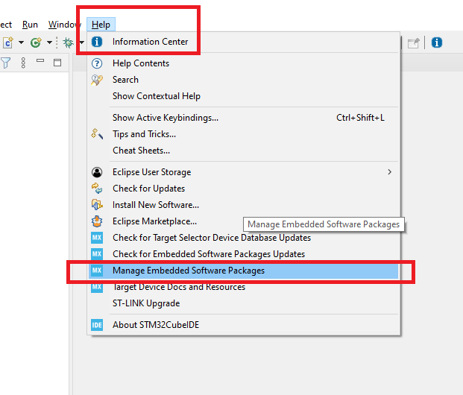
STM32CUBE IDE – Manage SW Package

Slide 9
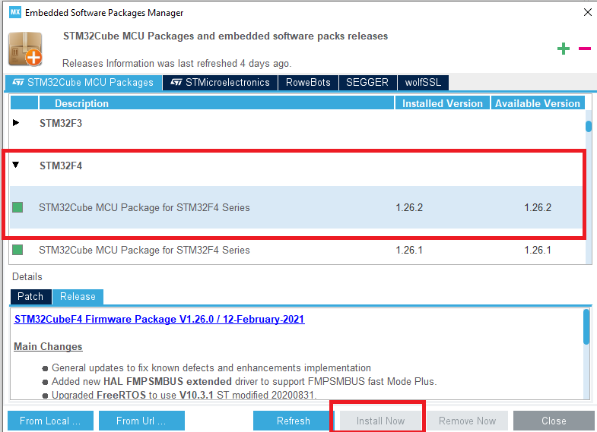
STM32CUBE IDE – Manage SW Package

Slide 10
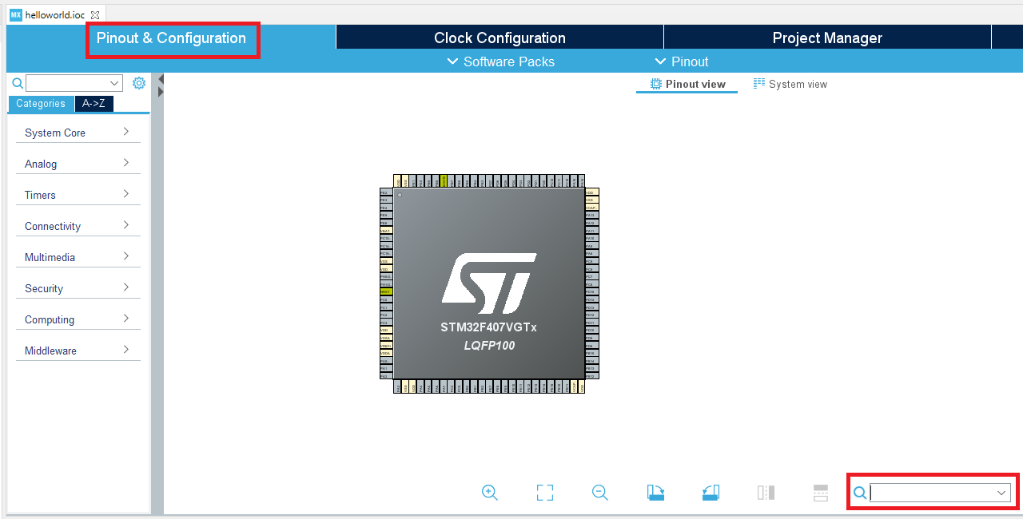
STM32CUBE IDE – Configuration

Slide 11
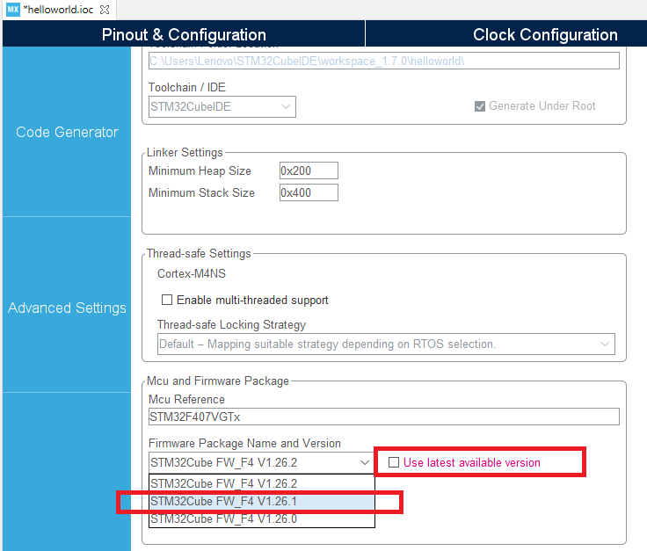
STM32CUBE IDE – Choose FW Version

Slide 12
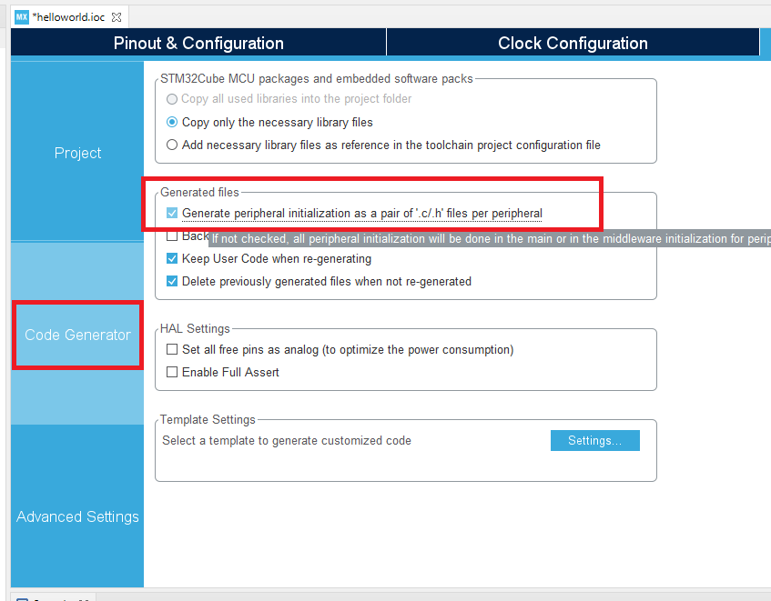
STM32CUBE IDE – Code Generator

Slide 13
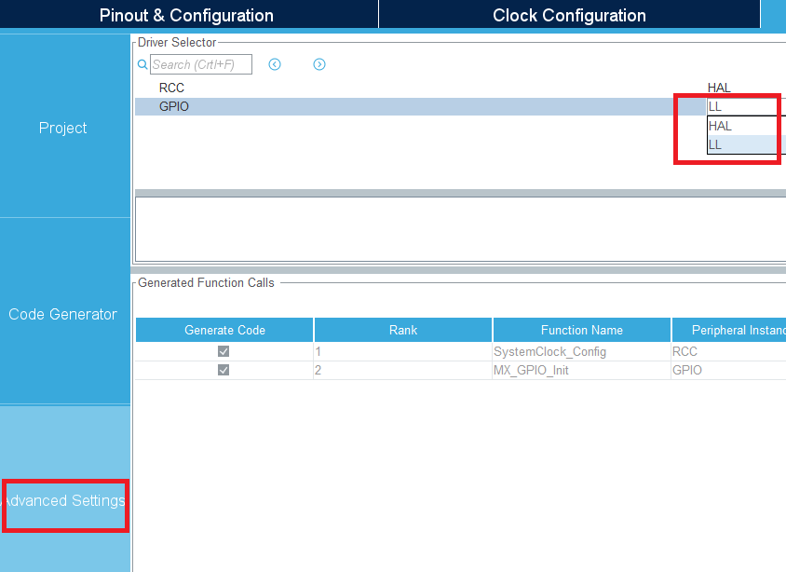
STM32CUBE IDE – Advanced Settings

Slide 14
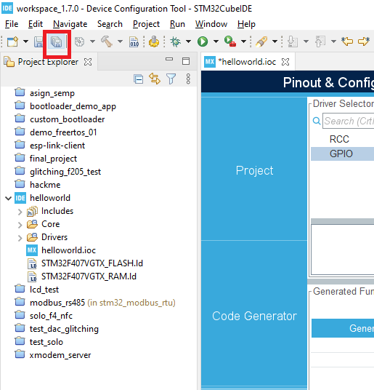
STM32CUBE IDE – Code Generation

Slide 15
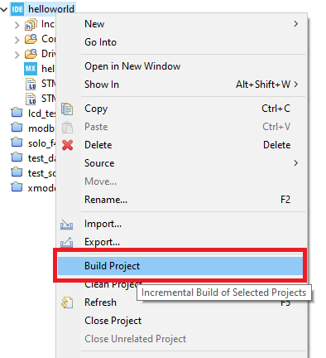
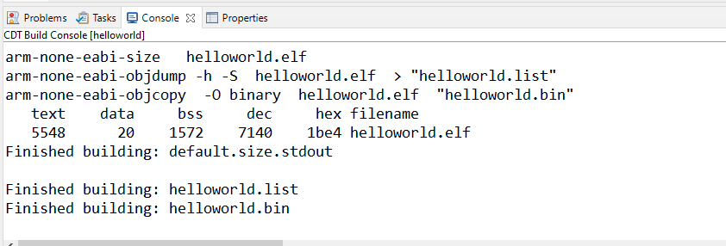
STM32CUBE IDE – Building

Slide 16
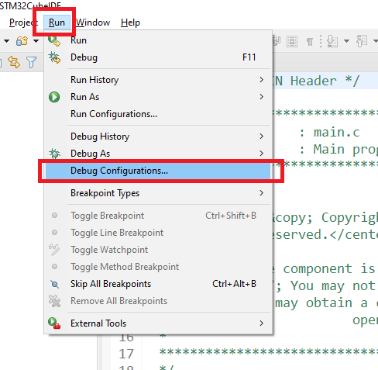
STM32CUBE IDE – Debug config

Slide 17
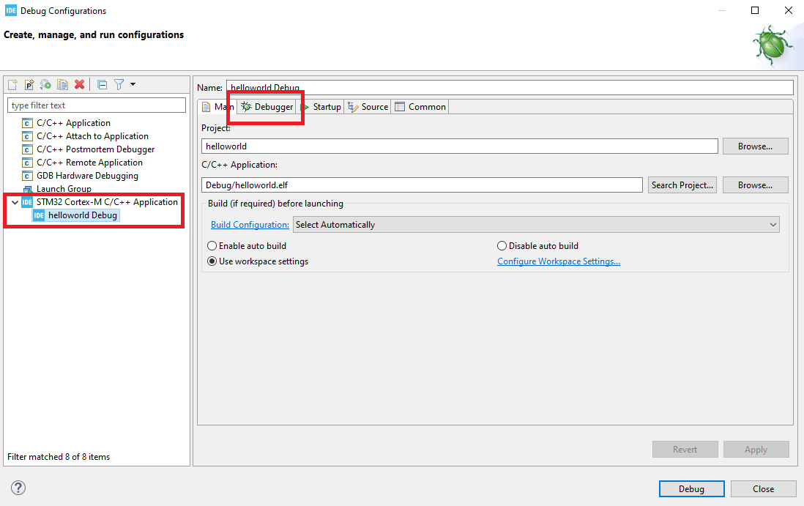
STM32CUBE IDE – Debug config

Slide 18
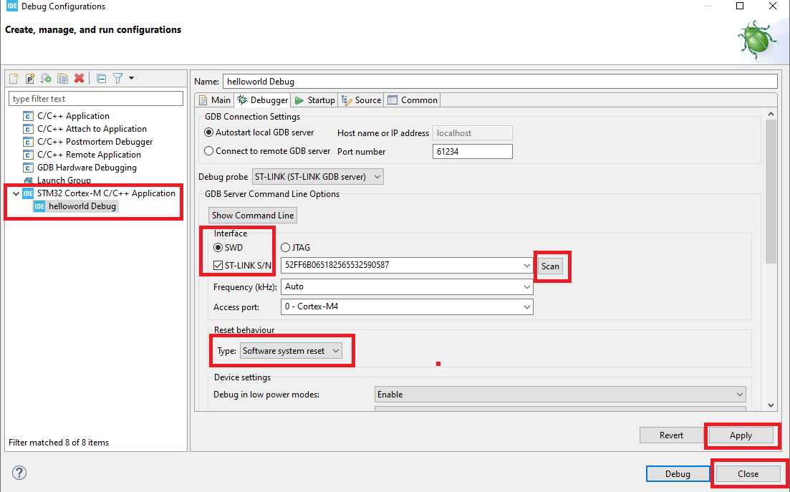
STM32CUBE IDE – Debug config

Slide 19
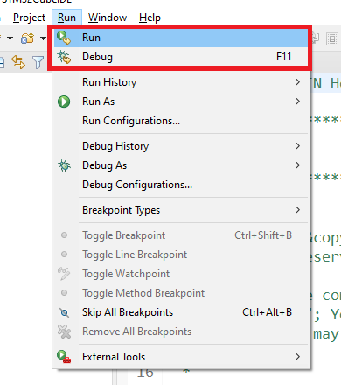
STM32CUBE IDE – Debug config

Slide 20
Question ?

